Slide 1
CHAPTER 18
Models for Time Series and Forecasting
to accompany
Introduction to Business Statistics
seventh edition, by Ronald M. Weiers
Presentation by Priscilla Chaffe-Stengel
Donald N. Stengel
© 2011 Cengage Learning.
All Rights Reserved. May not be scanned, copied, or duplicated, or posted to a publicly accessible website, in whole or in part.

Slide 2
Chapter 18 - Learning Objectives
Describe the trend, cyclical, seasonal, and irregular components of the time series model.
Fit a linear or quadratic trend equation to a time series.
Smooth a time series with the centered moving average and exponential smoothing techniques.
Determine seasonal indexes and use them to compensate for the seasonal effects in a time series.
Use the trend extrapolation and exponential smoothing forecast methods to estimate a future value.
Use MAD and MSE criteria to compare how well equations fit data.
Use index numbers to compare business or economic measures over time.
© 2011 Cengage Learning.
All Rights Reserved. May not be scanned, copied, or duplicated, or posted to a publicly accessible website, in whole or in part.

Slide 3
Chapter 18 - Key Terms
Time series
Classical time series model
  Trend value
  Cyclical component
  Seasonal component
  Irregular component
Trend equation
Moving average
Exponential smoothing
Seasonal index
Ratio to moving average method
Deseasonalizing
MAD criterion
MSE criterion
Constructing an index using the CPI
Shifting the base of an index
© 2011 Cengage Learning.
All Rights Reserved. May not be scanned, copied, or duplicated, or posted to a publicly accessible website, in whole or in part.

Slide 4
Classical Time Series Model
y = T • C • S • I
where y = observed value of the time series variable
T = trend component, which reflects the general tendency of the time series without fluctuations
C = cyclical component, which reflects systematic fluctuations that are not calendar-related, such as business cycles
S = seasonal component, which reflects systematic fluctuations that are calendar-related, such as the day of the week or the month of the year
I = irregular component, which reflects fluctuations that are not systematic
© 2011 Cengage Learning.
All Rights Reserved. May not be scanned, copied, or duplicated, or posted to a publicly accessible website, in whole or in part.

Slide 5
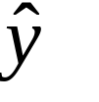
Trend Equations
Linear: = b₀ + b₁x
Quadratic: = b₀ + b₁x + b₂x²
= the trend line estimate of y
x = time period
b₀, b₁, and b₂ are coefficients that are selected to minimize the deviations between the trend estimates and the actual data values y for the past time periods. Regression methods are used to determine the best values for the coefficients.
© 2011 Cengage Learning.
All Rights Reserved. May not be scanned, copied, or duplicated, or posted to a publicly accessible website, in whole or in part.

Slide 6
Smoothing Techniques
Smoothing techniques - dampen the impacts of fluctuation in a time series, thereby providing a better view of the trend and (possibly) the cyclical components.
Moving average - a technique that replaces a data value with the average of that data value and neighboring data values.
Exponential smoothing - a technique that replaces a data value with a weighted average of the actual data value and the value resulting from exponential smoothing for the previous time period.
© 2011 Cengage Learning.
All Rights Reserved. May not be scanned, copied, or duplicated, or posted to a publicly accessible website, in whole or in part.

Slide 7
Moving Average
A moving average for a time period is the average of N consecutive data values, including the data value for that time period.
A centered moving average is a moving average such that the time period is at the center of the N time periods used to determine which values to average.
If N is an even number, the techniques need to be adjusted to place the time period at the center of the averaged values. The number of time periods N is usually based on the number of periods in a seasonal cycle. The larger N is, the more fluctuation will be smoothed out.
© 2011 Cengage Learning.
All Rights Reserved. May not be scanned, copied, or duplicated, or posted to a publicly accessible website, in whole or in part.

Slide 8
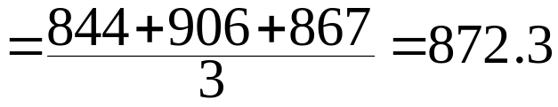
Moving Average - An Example
Time Period Data Value
2009, Quarter I 818
2009, Quarter II 861
2009, Quarter III 844
2009, Quarter IV 906
2010, Quarter I 867
2010, Quarter II 899
3-Quarter Centered Moving Average for 2009, Quarter IV:
4-Quarter Centered Moving Average for 2009, Quarter IV:
© 2011 Cengage Learning.
All Rights Reserved. May not be scanned, copied, or duplicated, or posted to a publicly accessible website, in whole or in part.

Slide 9
Exponential Smoothing
E_{t} = α•y_{t} + (1 – α) E_{t–1}
where
E_{t} = exponentially smoothed value for time period t
E_{t–1} = exponentially smoothed value for time period t – 1
y_{t} = actual time series value for time period t
α = the smoothing constant, 0 ≤ α ≤ 1
The larger α is, the closer the smoothed value will track the original data value. The smaller α is, the more fluctuation is smoothed out.
© 2011 Cengage Learning.
All Rights Reserved. May not be scanned, copied, or duplicated, or posted to a publicly accessible website, in whole or in part.

Slide 10
Exponential Smoothing - An Example
Data Smoothed Value Smoothed Value
Period Value (α = 0.2) (α = 0.8)
1 818 818 818
2 861 826.6 852.4
3 844 830.1 845.7
4 906 845.3 893.9
Calculation for smoothed value for Period 2 (α = 0.2):
E₂ = α y + (1 – α ) E₁
= 0.2 (861) + 0.8 (818) = 826.6
2
© 2011 Cengage Learning.
All Rights Reserved. May not be scanned, copied, or duplicated, or posted to a publicly accessible website, in whole or in part.

Slide 11
Seasonal Indexes
A seasonal index is a factor that adjusts a trend value to compensate for typical seasonal fluctuation in that period of a seasonal cycle.
A seasonal index is expressed as a percentage with a value of 100% corresponding to an average position in a seasonal cycle.
© 2011 Cengage Learning.
All Rights Reserved. May not be scanned, copied, or duplicated, or posted to a publicly accessible website, in whole or in part.

Slide 12
Seasonal Indexes - An Example
Season Index
(Annual Quarter) Value
I 84.5
II 102.3
III 95.5
IV 117.7
If the trend value for Quarter I in the given year was 902, the value with seasonal fluctuation would be
y = T • S = 902 • 84.5% = 762.2
© 2011 Cengage Learning.
All Rights Reserved. May not be scanned, copied, or duplicated, or posted to a publicly accessible website, in whole or in part.

Slide 13
Ratio to Moving Average Method
A technique for developing a set of seasonal index values from the original time series.
Steps:
  1. Construct a centered moving average of the time series. Set N = number of periods in the seasonal cycle.
  2. Express each original time series value as a percentage of the corresponding centered moving average. The result is the ratio to moving average.
    Example: If the original data value is 906 and the corresponding centered moving average is 872.3,
Ratio to moving average = (906/872.3) • 100 = 103.86
© 2011 Cengage Learning.
All Rights Reserved. May not be scanned, copied, or duplicated, or posted to a publicly accessible website, in whole or in part.

Slide 14
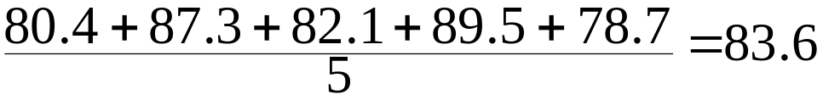
Ratio to Moving Average Method
Steps, cont.:
  3. For each period in the seasonal cycle, average all the ratio to moving average values (from Step 2) corresponding to that period in the seasonal cycle. The result is the unadjusted seasonal index for that period in the seasonal cycle.
    Example: If ratios corresponding to Quarter I are 80.4, 87.3, 82.1, 89.5, and 78.7, the unadjusted seasonal index value is
© 2011 Cengage Learning.
All Rights Reserved. May not be scanned, copied, or duplicated, or posted to a publicly accessible website, in whole or in part.

Slide 15
Ratio to Moving Average Method
Steps, cont.:
  4. The average of the seasonal index values should be 100.0 or their sum should be N•100. If not, multiply all seasonal index values by the appropriate adjustment factor, N•100 divided by the sum of unadjusted seasonal index values.
    Example: Unadjusted Adjusted
    Season Seasonal Index Seasonal Index
    I 83.60 83.83
    II 102.07 102.35
    III 95.42 95.68
    IV 117.81 118.34
Adjustment
Factor
=
4
⋅
100
=
1
.
00276
83
.
60
+
102
.
07
+
95
.
42
+
117
.
81
© 2011 Cengage Learning.
All Rights Reserved. May not be scanned, copied, or duplicated, or posted to a publicly accessible website, in whole or in part.

Slide 16
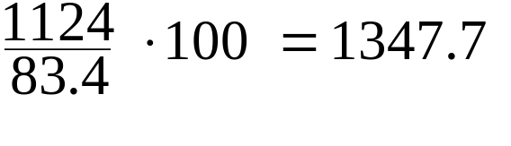
Deseasonalizing a Time Series
This procedure involves use of a seasonal index to remove the effect of typical seasonal fluctuation from a time series data value. The result is also called a seasonally-adjusted value.
  Example: If the original data value for the first quarter of a given year is 1124 and the seasonal index for Quarter I is 83.4, the seasonally-adjusted value is:
=
Original
Data
Value
⋅
Deseasonal
ized
Value
100
Seasonal
Index
for
Period
© 2011 Cengage Learning.
All Rights Reserved. May not be scanned, copied, or duplicated, or posted to a publicly accessible website, in whole or in part.

Slide 17
Forecasting with Classical Time Series Models
To forecast a value in a future time period:
  1. Use the trend equation to forecast the trend value for that time period.
  2. Adjust the data value using the cyclical and seasonal index values. If there is no cyclical index, do not do a cyclical adjustment.
© 2011 Cengage Learning.
All Rights Reserved. May not be scanned, copied, or duplicated, or posted to a publicly accessible website, in whole or in part.

Slide 18


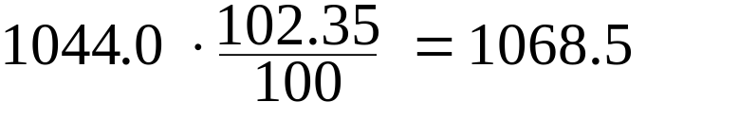
Forecasting with Classical Time Series Models - An Example
Example - Trend Equation:
  where = trend value
  x = number of quarters to 2009, Quarter IV
To forecast the value for 2011, Quarter II
Forecast of trend = 970.2 + 12.3 (6) = 1044.0
If the seasonal index for Quarter II is 102.35, the forecast with seasonal fluctuation is:
© 2011 Cengage Learning.
All Rights Reserved. May not be scanned, copied, or duplicated, or posted to a publicly accessible website, in whole or in part.

Slide 19
Forecasting with
Exponential Smoothing
A technique for generating a forecast for the next time period using the forecast and actual data value for the current time period. This technique is not valid if there is a significant upward or downward trend.
F_{t+1} = α y_{t} + (1 – α) F_{t} F_{t+1} = forecast for period t+1
y_{t} = actual value for period t
F_{t} = forecast for period t
α = smoothing constant, (0 ≤ α ≤ 1)
© 2011 Cengage Learning.
All Rights Reserved. May not be scanned, copied, or duplicated, or posted to a publicly accessible website, in whole or in part.

Slide 20
Forecasting with Exponential Smoothing - An Example
If the forecast for the current time period was 842 and the actual value was 872, using a smoothing constant of α = 0.6, the forecast for the next period is:
(0.6) (872) + (0.4) (842) = 860
© 2011 Cengage Learning.
All Rights Reserved. May not be scanned, copied, or duplicated, or posted to a publicly accessible website, in whole or in part.

Slide 21
Evaluating Time Series Models
Models can be evaluated using past data by examining the differences (or errors) between the values predicted from the models and the actual data values. The errors can be summarized and accuracy measured using either of the following criteria:
Mean Absolute Deviation (MAD) Criterion:
1. Express each difference as a positive number.
2. Find the average of the differences from Step 1.
Mean Squared Error (MSE) Criterion:
1. Square each error difference.
2. Find the average of the squared error differences from
Step 1.
© 2011 Cengage Learning.
All Rights Reserved. May not be scanned, copied, or duplicated, or posted to a publicly accessible website, in whole or in part.

Slide 22
Evaluating Time Series Models -
An Example
Value Actual
Computed Data Absolute Squared
By Model Value Deviation Error
1440 1436 4 16
1456 1461 5 25
1472 1480 8 64
1488 1472 16 156
1504 1495 9 81
Sums: 42 342
MAD = 42/5 = 8.4 MSE = 342/5 = 68.4
© 2011 Cengage Learning.
All Rights Reserved. May not be scanned, copied, or duplicated, or posted to a publicly accessible website, in whole or in part.

Slide 23
What are index numbers?
Index numbers:
  are time series that focus on the relative change in a count or measurement over time.
  express the count or measurement as a percentage of the comparable count or measurement in a base period.
© 2011 Cengage Learning.
All Rights Reserved. May not be scanned, copied, or duplicated, or posted to a publicly accessible website, in whole or in part.

Slide 24
Base Periods for Index Numbers
The base period is arbitrary but should be a convenient point of reference.
The value of an index number corresponding to the base period is always 100.
The base period may be a single period or an average of multiple adjacent periods.
© 2011 Cengage Learning.
All Rights Reserved. May not be scanned, copied, or duplicated, or posted to a publicly accessible website, in whole or in part.

Slide 25
Applications of Index Numbers in Business and Economics
A price index shows the change in the price of a commodity or group of commodities over time.
A quantity index shows the change in quantity of a commodity or group of commodities used or purchased over time.
A value index shows a change in total dollar value (price • quantity) of a commodity or group of commodities over time.
© 2011 Cengage Learning.
All Rights Reserved. May not be scanned, copied, or duplicated, or posted to a publicly accessible website, in whole or in part.

Slide 26
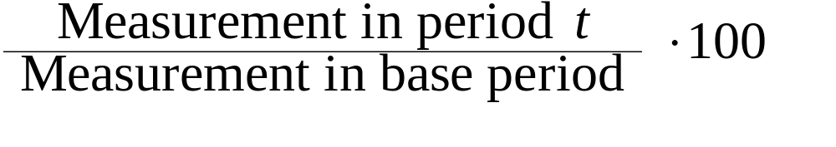
Simple Relative Index
A simple relative index shows the change in the price, quantity, or value of a single commodity over time.
Calculation of a simple relative index:
Index in period t =
© 2011 Cengage Learning.
All Rights Reserved. May not be scanned, copied, or duplicated, or posted to a publicly accessible website, in whole or in part.

Slide 27
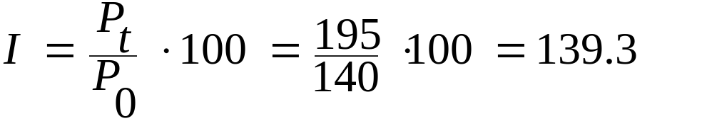
Example: Simple Relative Price Index
Price Index Price Index
Year Price 1990 as base year 2000 as base year
1990 $140 100.0 58.3
1995 195 139.3 81.3
2000 240 171.4 100.0
2005 275 196.4 114.6
Computation of index for 1995 (1990 as base year):
© 2011 Cengage Learning.
All Rights Reserved. May not be scanned, copied, or duplicated, or posted to a publicly accessible website, in whole or in part.

Slide 28
Consumer Price Index
A weighted aggregate price index used to reflect the overall change in the cost of goods and services purchased by a typical consumer.
Applications:
  Indicator of rate of inflation
  Used to adjust wages to compensate for lost purchasing power due to inflation
  Used to convert a price or wage to a real price or real wage to show the equivalent amount in a base period after adjusting for inflation.
© 2011 Cengage Learning.
All Rights Reserved. May not be scanned, copied, or duplicated, or posted to a publicly accessible website, in whole or in part.

Slide 29

Example: The CPI as Deflator
Suppose a person was earning $60,000 per year in 2008, when the CPI was 215.3 (base year: 1982-84 ). What was the person’s real income in its 1982-84 equivalent?
Real income in period t =
Income in period t •
Real earnings in 2001 = $60,000 • 100/215.3
= $27,868
© 2011 Cengage Learning.
All Rights Reserved. May not be scanned, copied, or duplicated, or posted to a publicly accessible website, in whole or in part.

Slide 30
Example: The CPI as Deflator
Suppose the same person was earning $50,000 per year in 2000, when the CPI was 172.2 (base year: 1982-84 ). What was the person’s real income in its 1982-84 equivalent?
Real earnings in 2000 = $50,000 • 100/172.2
= $29,036
The purchasing power of the person’s earnings was higher in 2000 than in 2008.
© 2011 Cengage Learning.
All Rights Reserved. May not be scanned, copied, or duplicated, or posted to a publicly accessible website, in whole or in part.

Slide 31
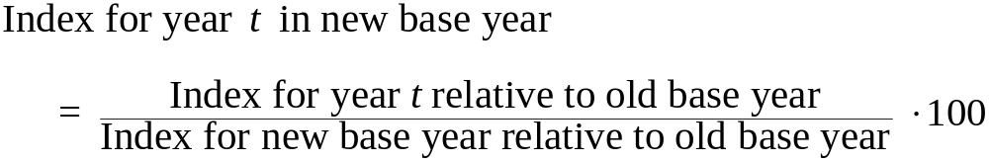
Shifting the Base of an Index
For useful interpretation, it is often desirable for the base year to be fairly recent.
To shift the base year to another year without recalculating the index from the original data:
© 2011 Cengage Learning.
All Rights Reserved. May not be scanned, copied, or duplicated, or posted to a publicly accessible website, in whole or in part.

Slide 32
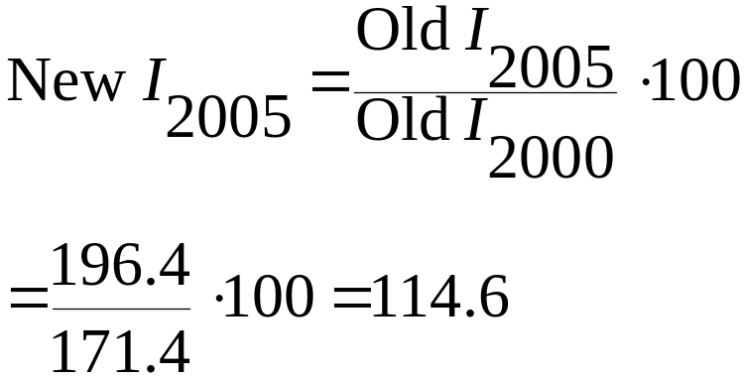
Example: Shifting a Base Year
To shift a base year from 1990 to 2000:
Price Index Price Index
Yr 1990 as base yr 2000 as base yr
1990 100.0 58.3
1995 139.3 81.3
2000 171.4 100.0
2005 196.4 114.6
An Illustration:
© 2011 Cengage Learning.
All Rights Reserved. May not be scanned, copied, or duplicated, or posted to a publicly accessible website, in whole or in part.

